Slide 1
California Google Business Reviews EDA
Group 30

Slide 2
Purpose
Explore and identify patterns and trends in review data
Uncover insights for further analysis and/or decision-making

Slide 3
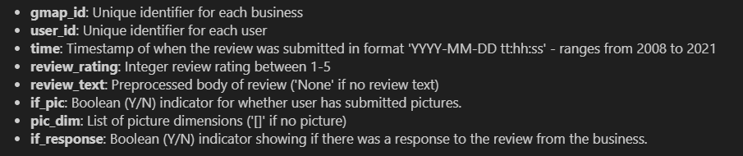
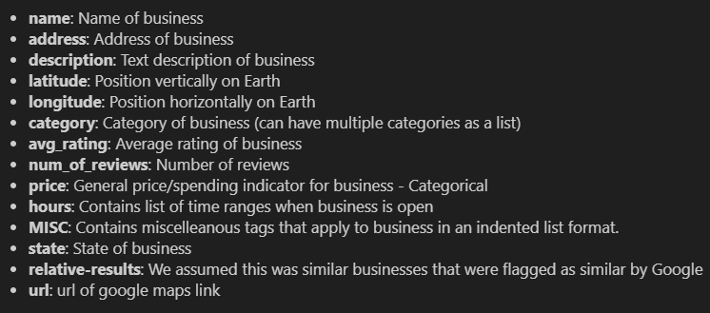
Datasets
Task 1 Output
.xlsx
Auxiliary Metadata
.json
Task 2 Output : Count Vectoriser and Vocab List
.txt

Slide 4
Methodology
Data Importing and Cleaning: Loaded datasets, check for missing values, data types
Data Exploration: Performed preliminary exploration to understand the data distribution and identify key variables.
Feature Engineering: Created new attributes and modified existing attributes to capture more meaningful insights.
Visualisation: Used various plots to visualise data trends and relationships between attributes

Slide 5
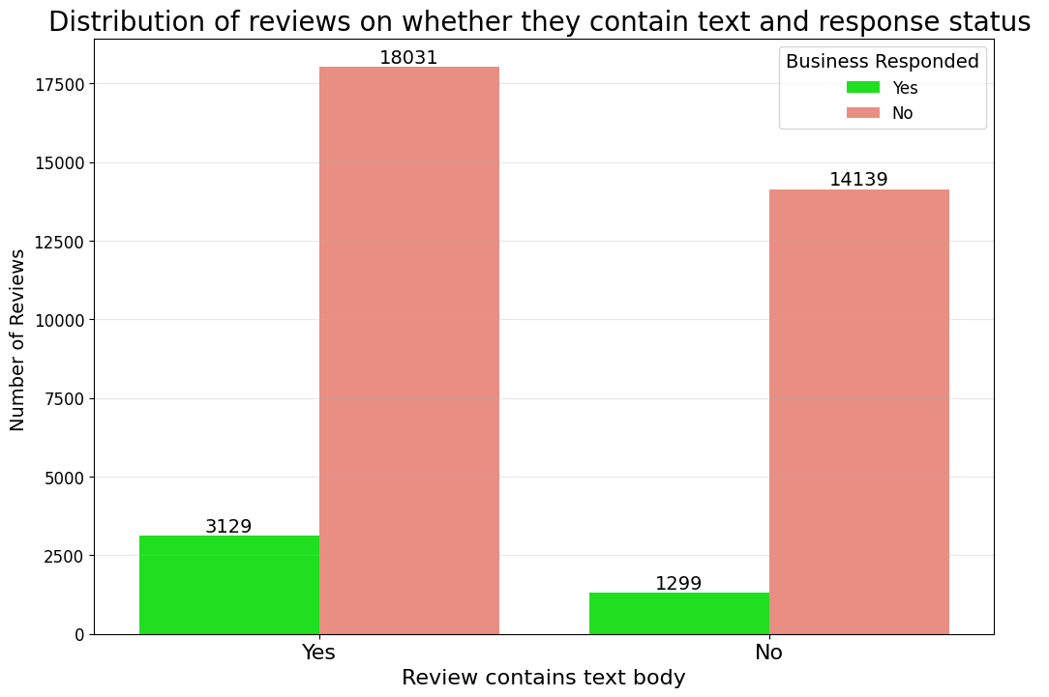
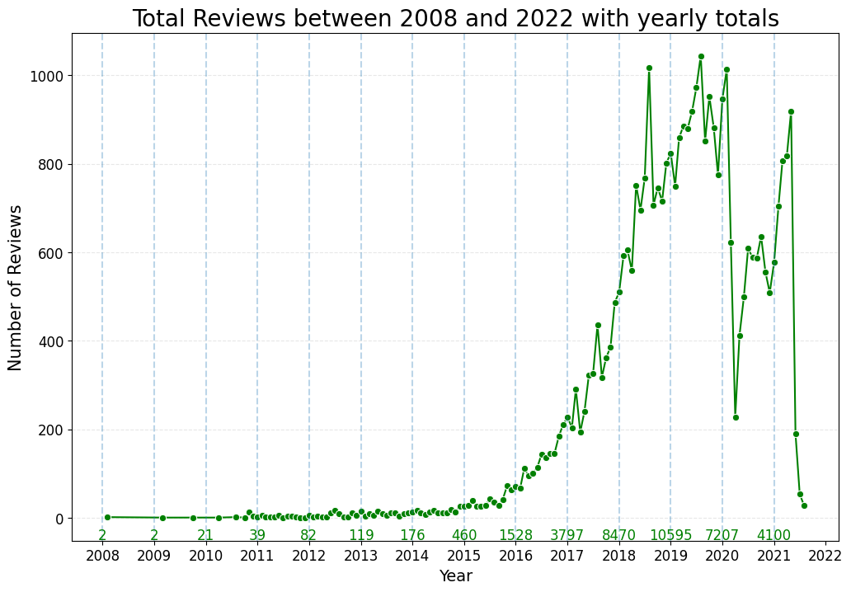
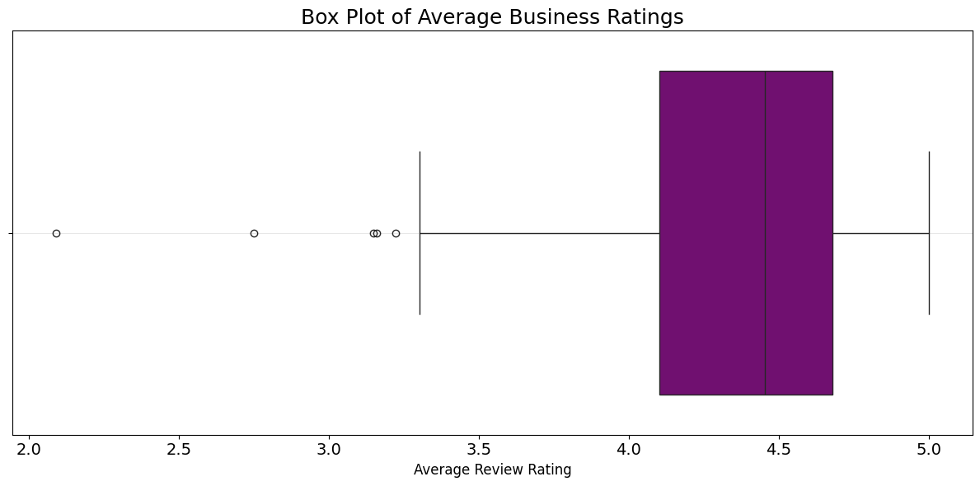
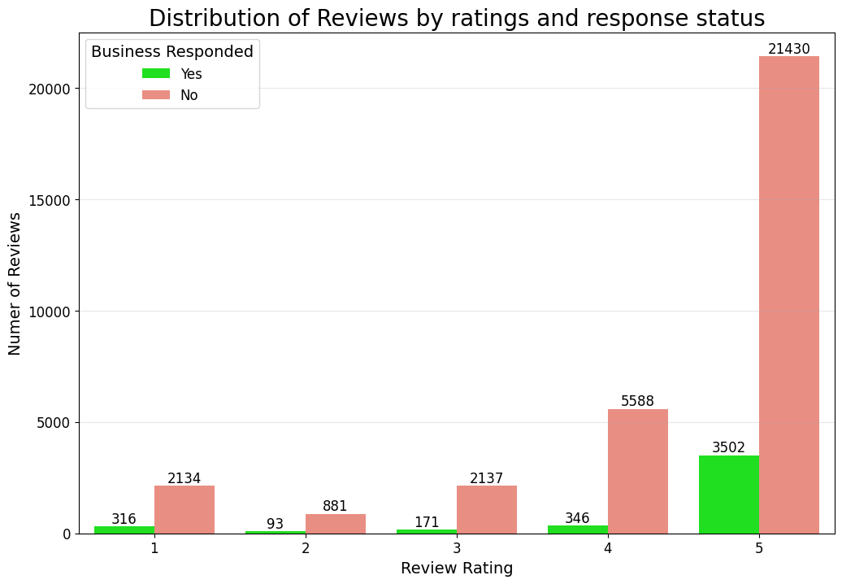

Slide 6

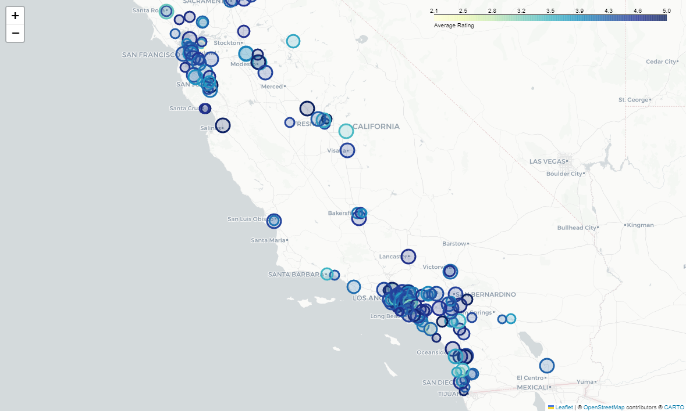
How does location affect business success?
Most businesses concentrated around major cities San Francisco and Los Angeles
No clear correlation between rating and location
Map of businesses in California and their average rating

Slide 7
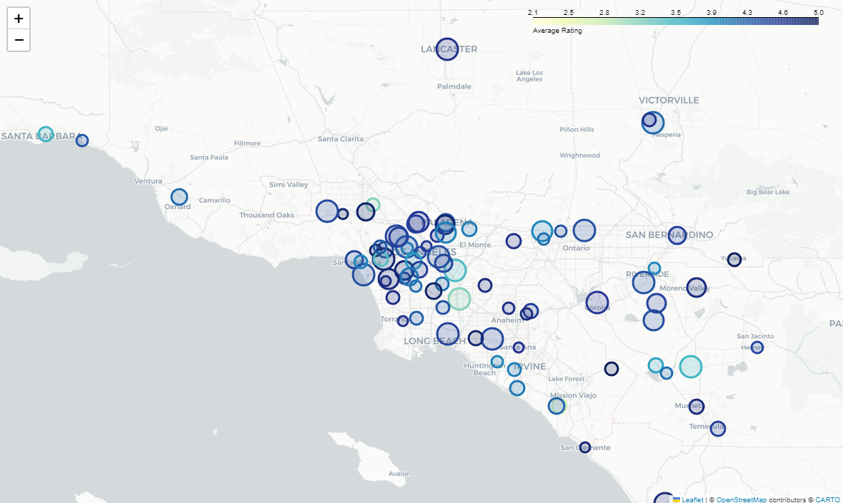
How does location affect business success?
No huge difference in rating or review amounts between urban and sub-urban areas
Perhaps not representative of all businesses in California
May be beneficial to cross-validate analysis with complete dataset
Map of businesses in Los Angeles and their average rating

Slide 8
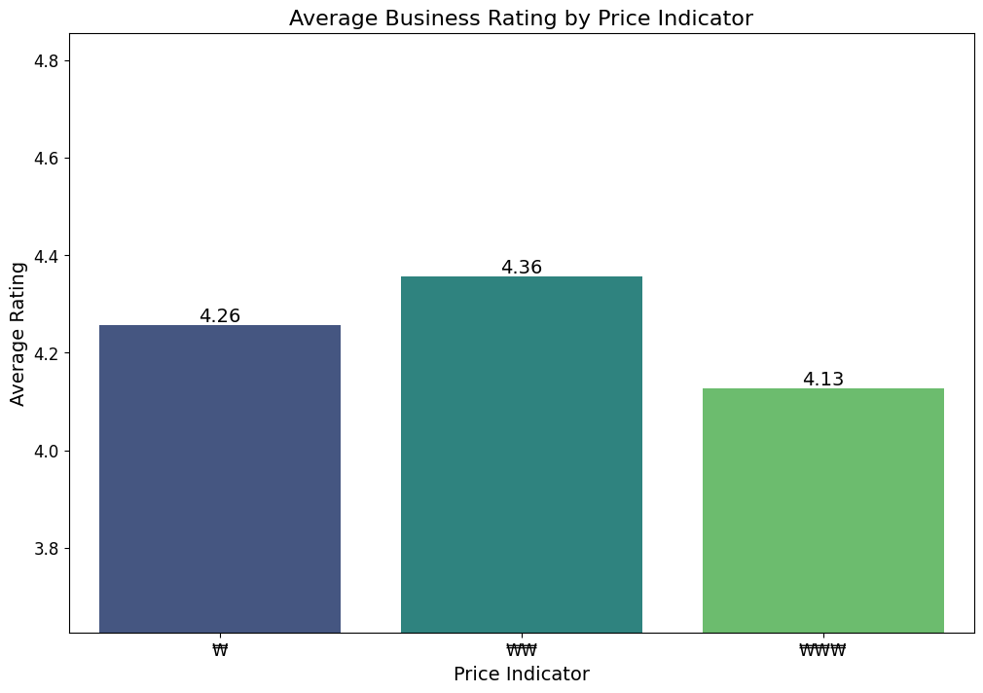
What are people’s views towards expected spending/price?
People in California have a slight preference for low and mid-range priced businesses
Focus on offering value for money
Assumes ₩ and $ are equivalent

Slide 9
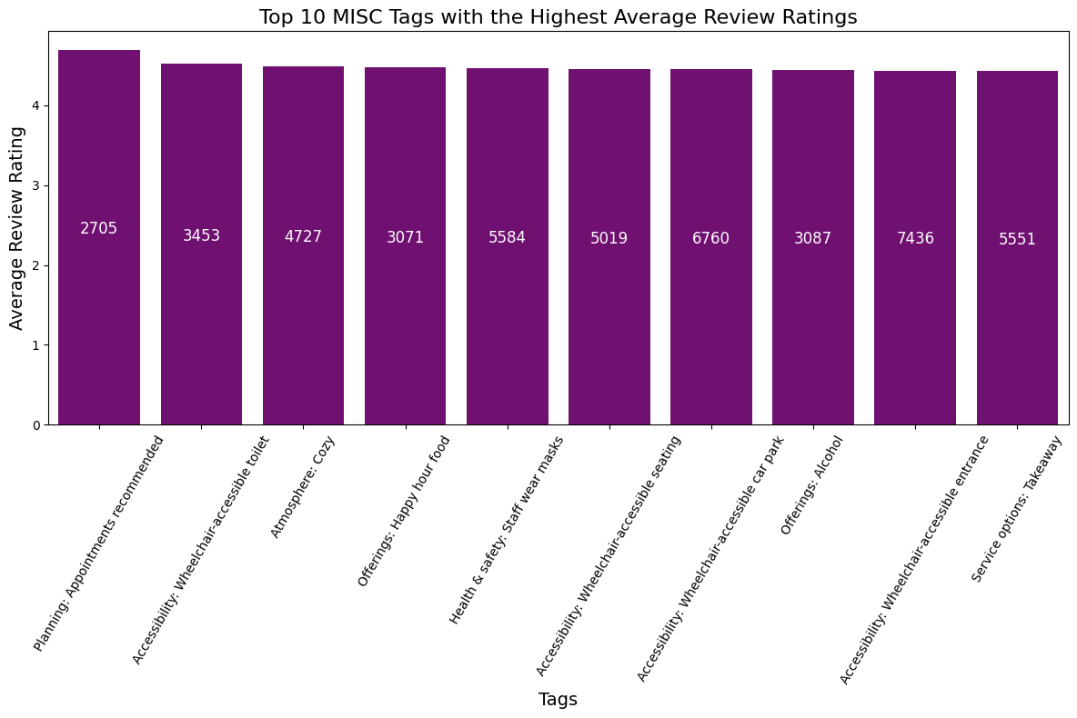
What are the most desirable miscellaneous tags for a business in California
Accessibility factors highly regarded
Health & Safety likely can be attributed to covid pandemic
May be wise to develop a Machine Learning model to more accurately determine specific combinations of tags

Slide 10
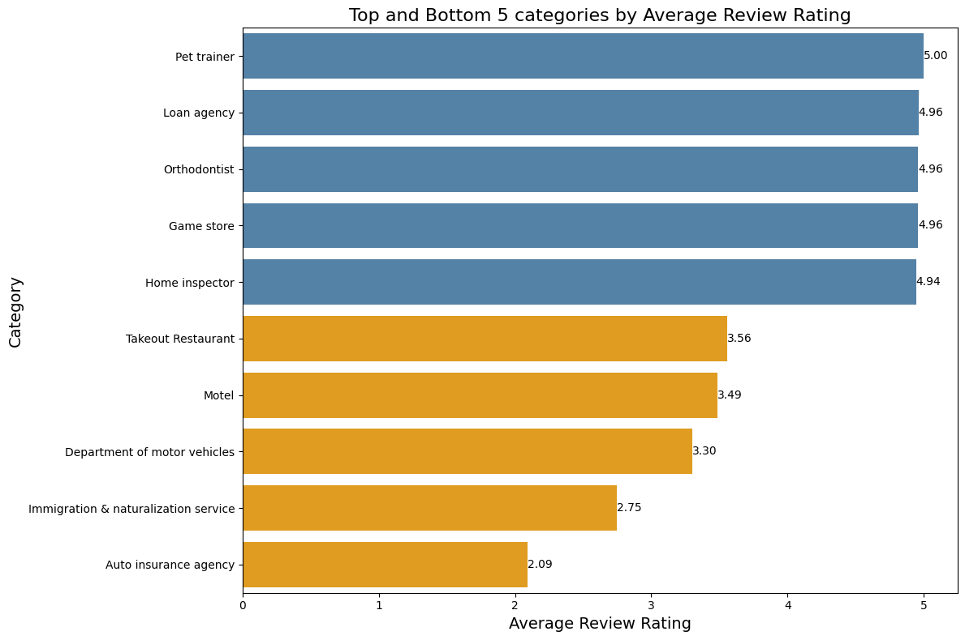
Which Business Categories are performing the best and worst?
Automobile industry is a potentially rewarding business prospect
Dentistry, loan agencies and game stores are already at a high enough standard for Californian consumers
Limitation: Layer of abstraction that may cause information loss

Slide 11
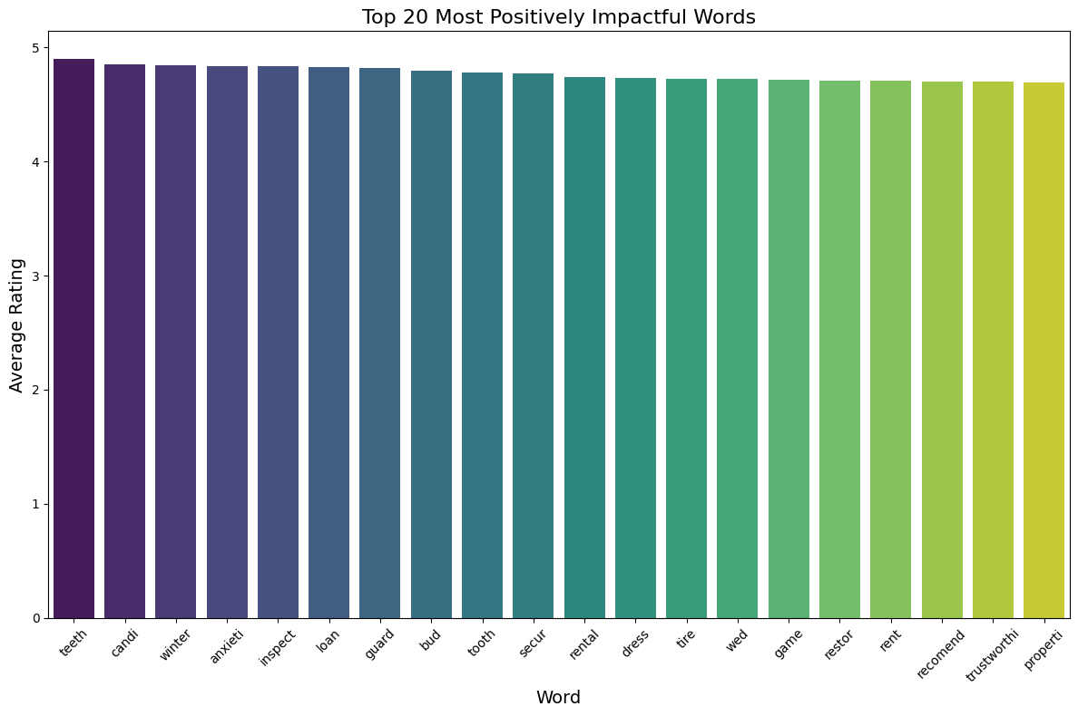
Review Textual Analysis
Positively connotated words: ‘candy’, ‘secure’, ‘restore’, ‘recommend’, ‘trustworthy’
Field specific words: Dentistry - ‘teeth’, ‘tooth’, ‘restore’; Real Estate – ‘loan’, ‘rent’, ‘rental’, ‘inspect’
Overlaps with category analysis

Slide 12
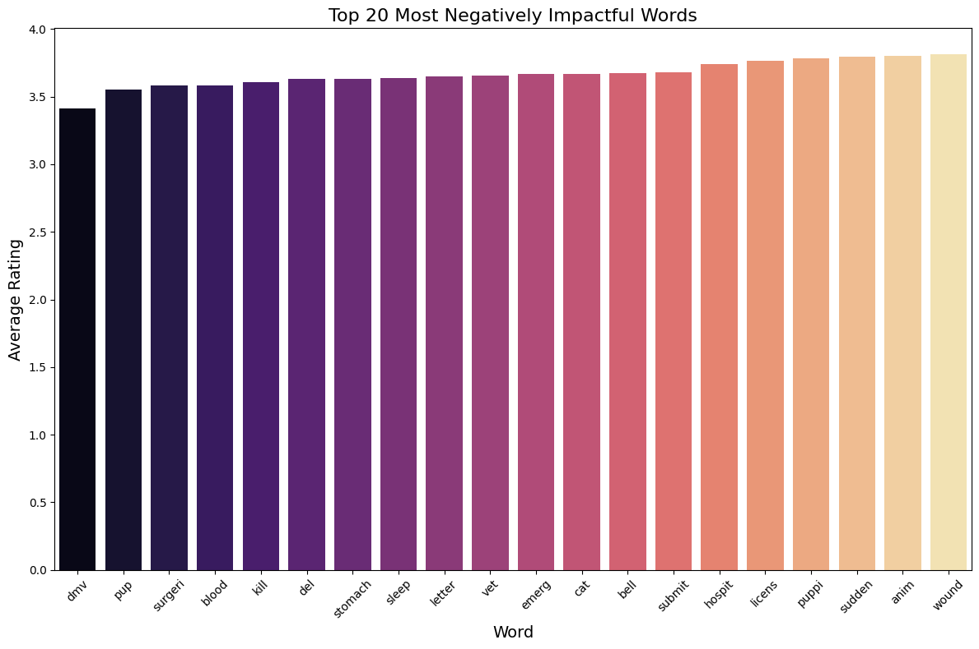
Review Textual Analysis
Negatively connotated words: ‘blood’, ‘kill’, ‘wound’
Field-specific words: Veterinarian – ‘pup’, ‘cat’, ‘puppy’; Hospital – ‘stomach’, ‘emergency’, ‘surgery’
Reveals fields Californian people are less happy with
Should apply word frequency as a weight

Slide 13
Conclusion
Veterinarian and automobile are two industries that are worth exploring
Aim to provide services which offer high return/value for customers, rather than catering towards luxury services that most people cannot afford
No need to concern too much with locating in CBD
Ensure business follows strict health regulations and protocols, as well as offer inclusive accessibility option

Slide 14
Conclusion
Category Abstraction
Building Machine Learning models

